Slide 1
Notes on the syllabus
Do not call me on the phone after 10:00 PM, or before 7:00 AM. Do not use Teams to contact me, because I do not check it regularly.
I take code plagiarism seriously, and if I detect it, you may get an F grade on the assignment, or in the whole course.
The last four assignments, in pairs (8, 9) and (10, 11) will be done by groups of 3 students and presented orally in class.
The week’s textbook reading should be finished by Wednesday’s class and there may be a quiz that day on its content (and lecture content), so please bring paper and a pen or pencil to class on Wednesdays. But there is no quiz today, because Monday’s class was cancelled. There may be one on Friday. There may also be Moodle quizzes.
Friday classes are not optional; I will take attendance.
Since there are two remote students, the classes will usually be recorded on teams, and you can use the recordings to study from, but you are still required to be present in class for roll call.

Slide 2
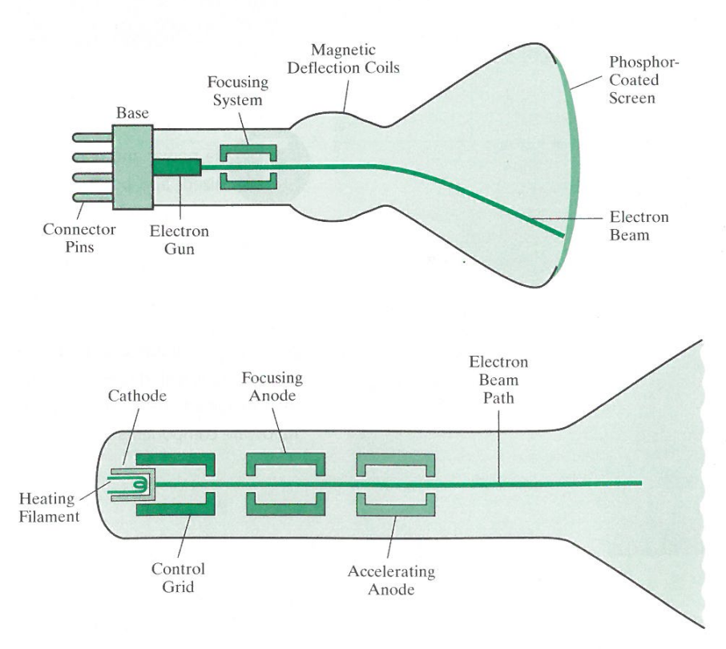
Display technology

Slide 3
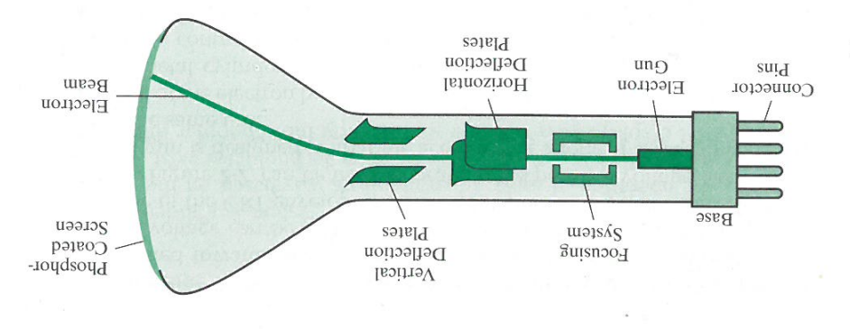
Electrostatic deflection

Slide 4
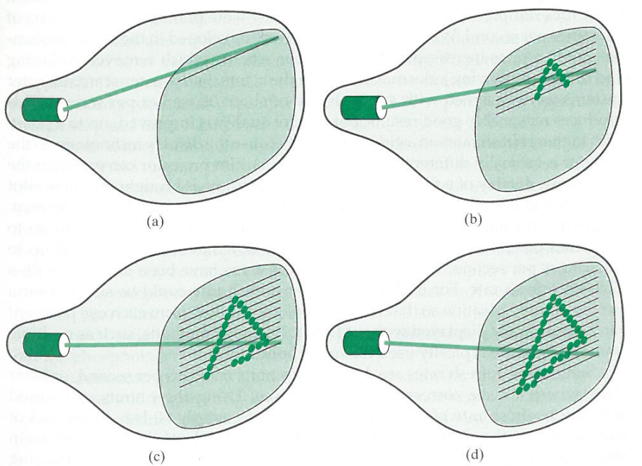
Raster image

Slide 5
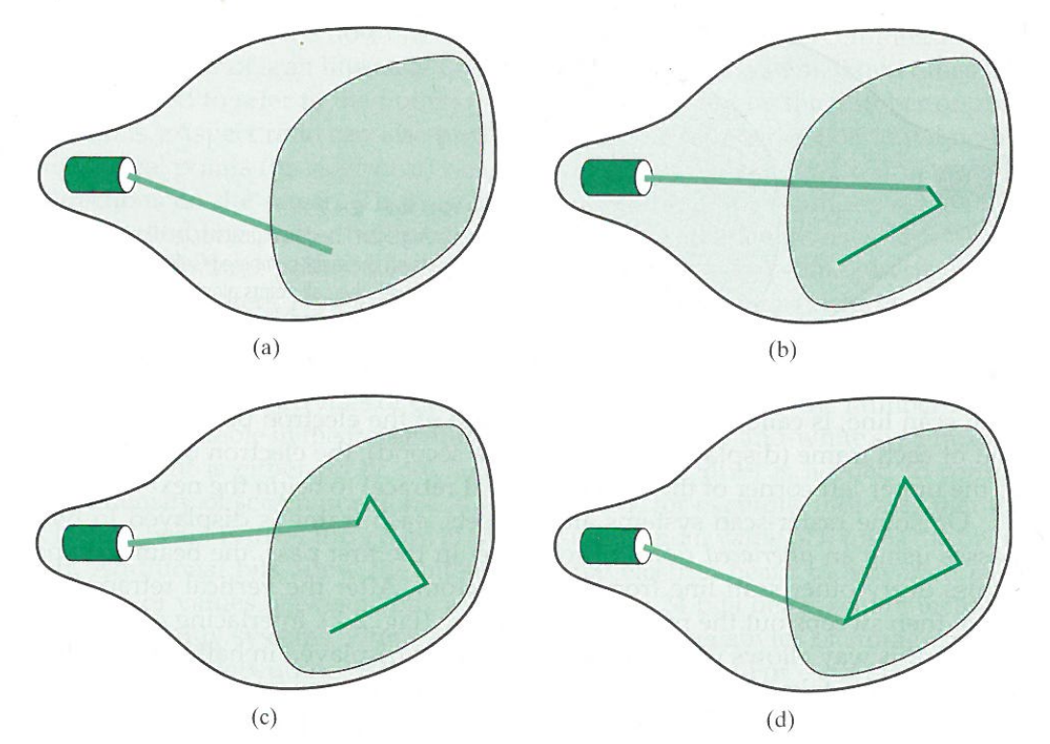
Vector image

Slide 6
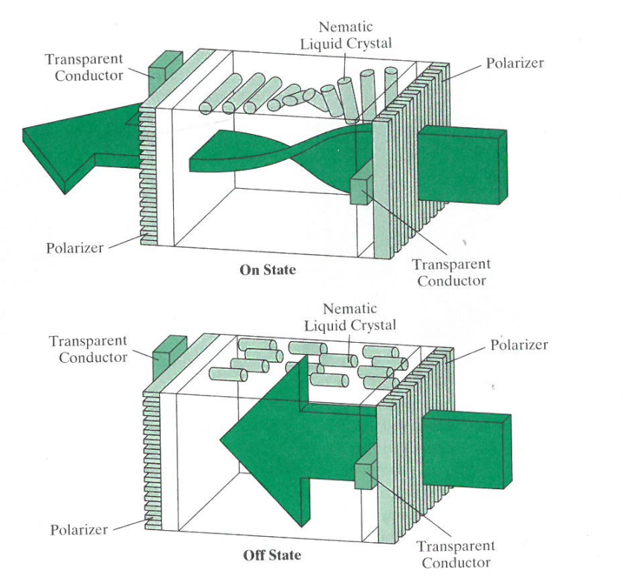
LCD Display

Slide 7
CPU Graphics
CPU
DRAM
System
Memory
VRAM
Frame
Buffer
Display
BUS

Slide 8
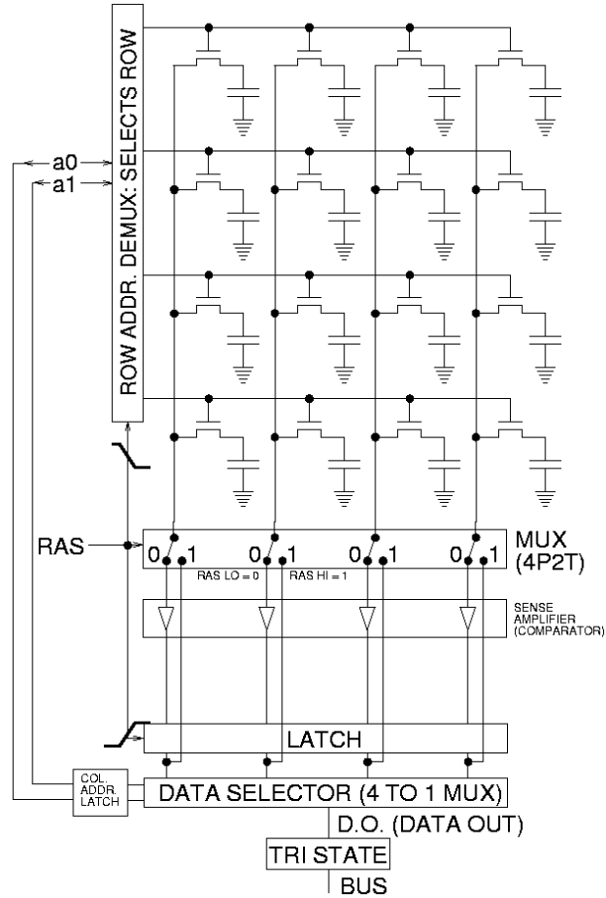
DRAM
By Glogger at English Wikipedia - Transferred from en.wikipedia to Commons., CC BY-SA 3.0, https://commons.wikimedia.org/w/index.php?curid=5549293
Taken from https://en.wikipedia.org/wiki/Dynamic_random-access_memory. Relevant part in Moodle: Week 1: DRAM.docx.

Slide 9
VRAM
By Glogger at English Wikipedia - Transferred from en.wikipedia to Commons., CC BY-SA 3.0, https://commons.wikimedia.org/w/index.php?curid=5549293,modified by Nelson Max
For a single chip, there may be 8 copies of the memory and shift register, so a byte can be output on each cycle.
Shift
clock
Video
output
Shift register

Slide 10
GPU Graphics
CPU
DRAM
System
Memory
GPU with
Frame
Buffer
Display
BUS

Slide 11
Simplified GPU Hardware External Memory
On-Chip Caches
Frame buffer 1
Video out
color
Frame buffer 2
depth
Depth Buffer
texture
Texture Memory
Multiple “warps” of SIMD processors

Slide 12
Simplified GPU Hardware External Memory
On-Chip Caches
Frame buffer 1
Video out
color
Frame buffer 2
depth
Depth Buffer
texture
Texture Memory
Multiple “warps” of SIMD processors

Slide 13
Conceptual GPU data flow diagram
per-vertex
data
Vertex
Shader
program
Scan conversion
and variable
data interpolation
transformed
per-vertex data
fragments with
per-fragment data
texel address
Fragment
Shader
program
Texture
Memory
texel
data
Bilinear
texture
interpolation
data from
4 texels
pixel address
Active
Frame
Buffer
RGBA color
RGBA
Compositing
and
Depth Test
depth
depth
Depth
Buffer

Slide 14
Multithreading
The access to texture memory is much slower than the arithmetic speed of the individual GPU processors. So each processor is multithreaded, using register space to store the state of one thread’s computation while the processor continues with another thread of its SIMD program.

Slide 15
Drawing lines
The rest of this lecture is about programs to draw lines in software.
We start by deriving the two-point equation for a line.

Slide 16
Two-point equation for a line through points P1 = (x1, y1) and P2 = (x2, y2):
Y
y2
P2 = (x2, y2)
y1
P1 = (x1, y1)
X
x1
x2

Slide 17
Two-point equation for a line through points P1 = (x1, y1) and P2 = (x2, y2):
For a general point P = (x, y) on the line, find an equation for y in terms of x.
Y
y2
P2 = (x2, y2)
y
P = (x, y)
y1
P1 = (x1, y1)
X
x1
x
x2

Slide 18
Two-point equation for a line through points P1 = (x1, y1) and P2 = (x2, y2):
Y
Triangle P A P1 is similar to triangle P2 B P1
y2
P2 = (x2, y2)
y
P = (x, y)
y1
B
P1 = (x1, y1)
A
X
x1
x
x2

Slide 19
Two-point equation for a line through points P1 = (x1, y1) and P2 = (x2, y2):
Y
Triangle P A P1 is similar to triangle P2 B P1. So the ratio of the vertical side to the horizontal side is the same for each:
P A P2 B
A P1 B P1
y2
P2 = (x2, y2)
y
P = (x, y)
=
y1
B
P1 = (x1, y1)
A
X
x1
x
x2

Slide 20
Two-point equation for a line through points P1 = (x1, y1) and P2 = (x2, y2):
Y
Triangle P A P1 is similar to triangle P2 B P1. So the ratio of the vertical side to the horizontal side is the same for each:
P A P2 B
A P1 B P1
y – y1 y2 – y1
x – x1 x2 – x1
y2
P2 = (x2, y2)
y
P = (x, y)
=
y1
B
P1 = (x1, y1)
A
=
X
x1
x
x2

Slide 21
Two-point equation for a line through points P1 = (x1, y1) and P2 = (x2, y2):
Y
y – y1 y2 – y1
x – x1 x2 – x1
y – y1 = (x – x1)
y = x + y1 – x1
y = m x + b
=
y2
P2 = (x2, y2)
y
P = (x, y)
y2 – y1
x2 – x1
y1
B
y2 – y1
x2 – x1
y2 – y1
x2 – x1
P1 = (x1, y1)
A
b
X
x1
x
x2
slope
Y intercept

Slide 22
When x increases by 1, y increases by the slope m.
Y
y = f(x) = mx + b
f(x+1) = m(x + 1) + b
= mx + m + b
= (mx + b) + m
= y + m
f(x+1)
m
y
1
b
X
x x + 1

Slide 23
Drawing a line with one pixel in each column

Slide 24
Given P1 and P2, find the pixel center in each column nearest to the line P1 P2.
Y
Pixel edges are at integer positions, and pixels are named by their lower left corners.
x0 = floor(x1)
Pixel center x is xc = x0 + .5
y2
P2
y1
yc
P1 = (x1, y1)
X
x0
xc
x1
x2

Slide 25
Given P1 and P2, find the pixel center in each column nearest to the line P1 P2.
Y
Pixel edges are at integer positions, and pixels are named by their lower left corners.
x0 = floor(x1)
Pixel center xc = x0 + .5
y2
P2
y1
yc
P1 = (x1, y1)
X
xc
x2
x0
x1

Slide 26
Given P1 and P2, find the pixel center in each column nearest to the line P1 P2.
Y
Pixel edges are at integer positions, and pixels are named by their lower left corners.
x0 = floor(x1)
Pixel center xc = x0 + .5
yc = f(xc) = m xc + b
y1 = f(x1) = m x1 + b
yc – y1 = m (xc – x1)
yc = y1 + m (xc – x1)
The first pixel is (x0, floor(y)).
y2
P2
y1
yc
P1 = (x1, y1)
X
xc
x2
x0
x1

Slide 27
Given P1 and P2, find the pixel center in each column nearest to the line P1 P2.
Y
x0 = floor(x1)
Pixel center xc = x0 + .5
yc = y1 + m (xc – x1)
The first pixel is (x0, floor(yc)).
Next column center xn = xc + 1.
yn = f(xn) = yc + m
y2
P2
yn
y1
yc
P1 = (x1, y1)
X
xc
x2
x0
x1
xn

Slide 28
Given P1 and P2, find the pixel center in each column nearest to the line P1 P2.
Y
x0 = floor(x1)
Pixel center xc = x0 + .5
yc = y1 + m (xc – x1)
= y1 + m (x0 + .5 – x1)
The first pixel is (x0, floor(yc)).
Next column center xn = xc + 1.
yn = f(xn) = yc + m
The pixel in this next column closest to the line P1 P2 is
(floor( xn), floor(yn) ).
y2
P2
yn
y1
yc
P1 = (x1, y1)
X
xc
x2
x0
x1
xn

Slide 29
When x increases by 1, y increases by the slope m.
Y
y = f(x) = mx + b
f(x+1) = m(x + 1) + b
= mx + m + b
= (mx + b) + m
= y + m
f(x+1)
m
y
1
b
X
x x + 1

Slide 30
Given P1 = (x1, y1) and P2 = (x2, y2), find pixel centers near the line P1 P2
Y
General method for the pixel in the next column:
x = x + 1
y = y + m
Next pixel = ( x, floor(y) )
y2
P2
y
m
yn
1
y1
yc
P1 = (x1, y1)
X
xc
x
x2
x0
x1
xn

Slide 31
Given P1 and P2, find the pixel center in each column nearest to the line P1 P2.
Y
General method for the pixel in the next column:
x = x + 1
y = y + m
Next pixel = ( x, floor(y) )
y2
P2
y
yn
y1
yc
P1 = (x1, y1)
X
xc
x
x2
x0
x1
xn

Slide 32
Given P1 and P2, find the pixel center in each column nearest to the line P1 P2.
Y
General method for the pixel in the next column:
x = x + 1
y = y + m
Next pixel = ( x, floor(y) )
C/C++ code for this blue line:
m = (y2 – y1)/(x2 – x1); // slope
x0 = floor(x1) // an integer
y = y1 + m*(x + .5 – x1);
for (int x = x0; x < floor(x2); ++x) {
iy = floor(y);
set_pixel (x, iy, 0, .5, 1);
y += m;
}
y2
P2
y
yn
y1
yc
P1 = (x1, y1)
X
xc
x
x2
x0
x1
xn

Slide 33
Given P1 and P2, find the pixel center in each column nearest to the line P1 P2.
Y
General method for the pixel in the next column:
x = x + 1
y = y + m
Next pixel = ( x, floor(y) )
C/C++ code for this blue line:
m = (y2 – y1)/(x2 – x1); // slope
x = floor(x1) // = x0, an integer
y = y1 + m*(x + .5 – x1);
for (int x = x0; x < floor(x2); ++x) {
iy = floor(y);
set_pixel (x, iy, 0, .5, 1);
y += m;
}
y2
P2
y
yn
y1
yc
P1 = (x1, y1)
X
xc
x
x2
x0
x1
xn

Slide 34
Given P1 and P2, find the pixel center in each column nearest to the line P1 P2.
Y
General method for the pixel in the next column:
x = x + 1
y = y + m
Next pixel = ( x, floor(y) )
C/C++ code for this blue line:
m = (y2 – y1)/(x2 – x1); // slope
x = floor(x1) // = x0, an integer
y = y1 + m*(x + .5 – x1);
for (int x = x0; x < floor(x2); ++x) {
iy = floor(y);
set_pixel (x, iy, 0, .5, 1);
y += m;
}
y2
P2
y
yn
y1
yc
P1 = (x1, y1)
X
xc
x
x2
x0
x1
xn

Slide 35
Note that the last pixel is not set, so that it will not be drawn twice in a set of consecutive line segments, each one starting where the last one ended. This is important if the lines are partially transparent.
As written, this code is good only for lines with x2 >= x1, since the for loop increments x. For the case x2 < x1, you cannot simply swap (x1, y1) and (x2, y2), because then the last pixel ( floor(x2), floor(y2) ) will be drawn, instead of the first pixel, violating the above rule. So for homework you need to modify the for loop to handle decreasing x also, or else write a different version for that case.
This code is good for both positive and negative slopes, of absolute values <= 1, since it chooses exactly one row pixel in each column. It is not good for steeper slopes, so for homework you will have to create an alternative version for steeper lines, which instead chooses one row pixel in each column, by stepping through rows instead of columns.

Slide 36
My compile and link command line in Linux was:
gcc –o Line_x Line_x.cpp bmp.h –lm
or if I wanted to use gdb for debugging,
gcc –g –o Line_x Line_x.cpp bmp.h –lm .
Your goal for homework is to revise Line_x.cpp to a version Line.cpp that can draw a whole circle, not just a quarter of one. You should revise “n = 10” to “n = 40” for the whole circle, since it will need 4 times as many line segments.

Slide 37
#define width 400
#define height 400
#define image_size 3*width*height
unsigned char image[image_size];
void set_pixel(int x, int y, double r, double g, double b) {
int index;
if (x >= 0 && x < width && y >= 0 && y < height) {
index = 3*(x + width*y);
image[index ] = (unsigned char) 255*r;
image[index+1] = (unsigned char) 255*g;
image[index+2] = (unsigned char) 255*b;
}
}

Slide 38
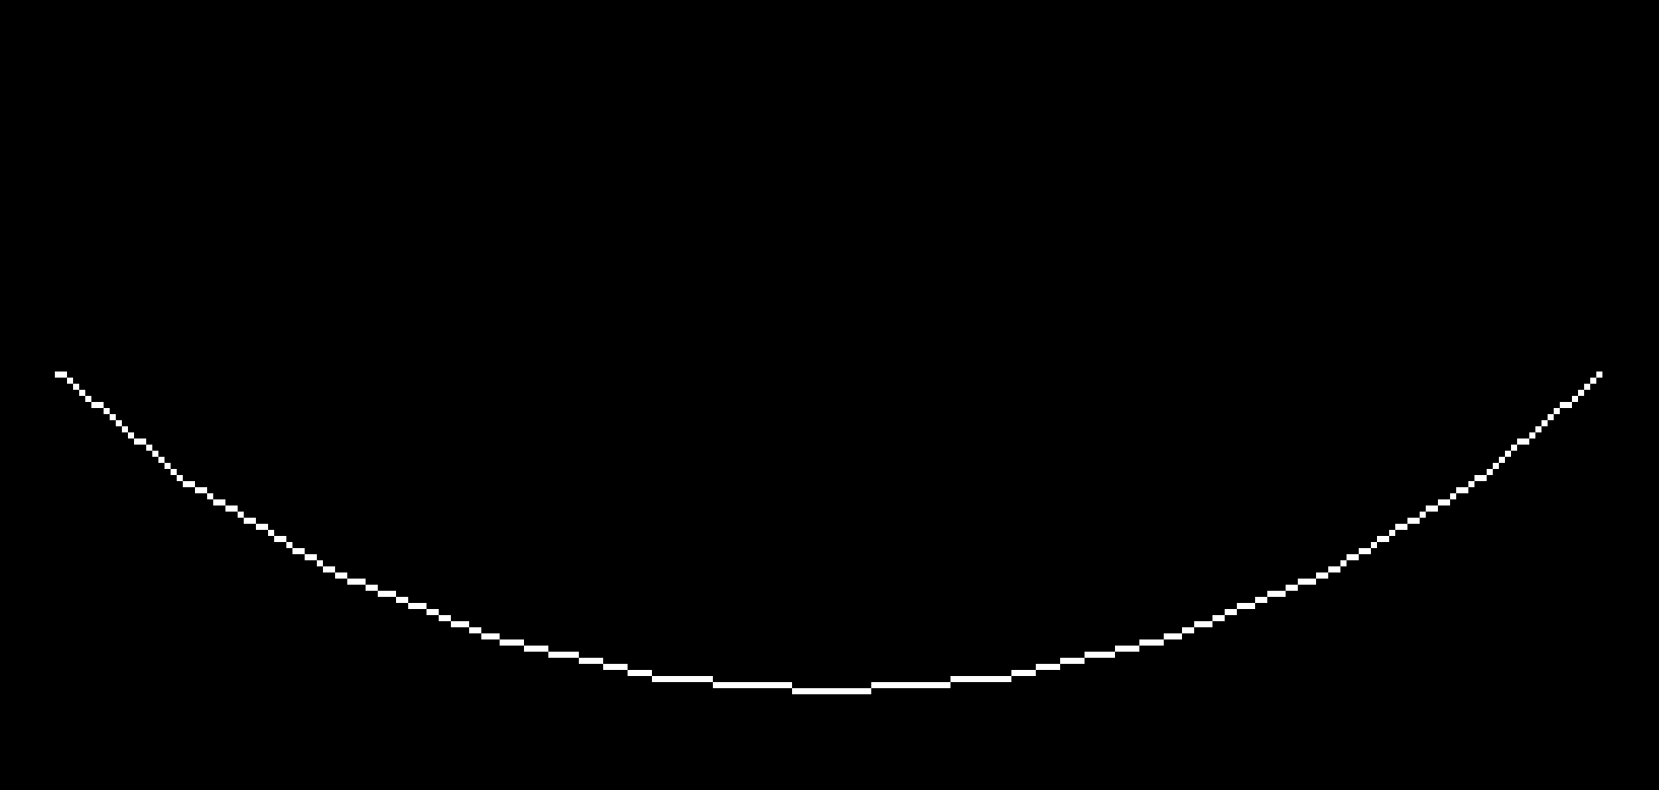
BMP image produced by Line_x.cpp Note the sudden vertical jumps by one pixel. The line has “jaggies”.

Slide 39
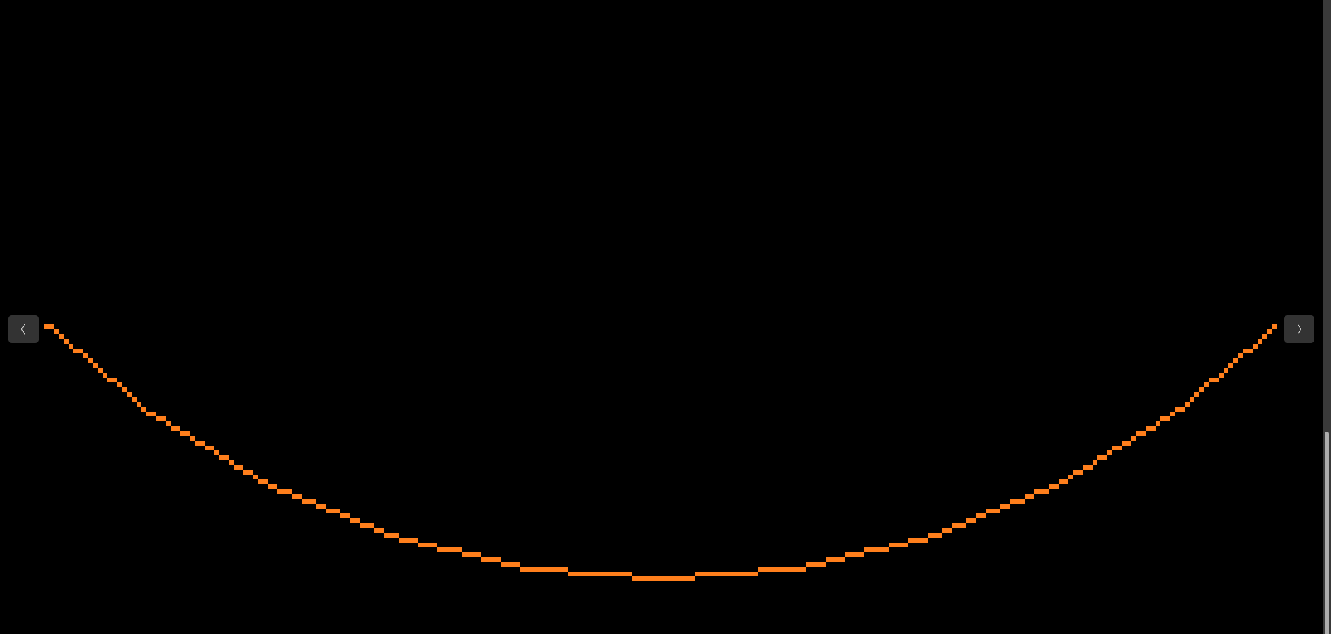
BMP image produced by Colored_Line_x.cpp Note the sudden vertical jumps by one pixel. The line has “jaggies”.

Slide 40
Remove the “jaggies” by antialising using two pixels in each column.
Y
C = (xc, yc) is the center of a pixel.
P = (xc, f(xc) ) is a point on the line inside that pixel. Here, P is a little above C, but still in the pixel, so color that pixel a little bit less, and color the pixel above it a little bit more.
The amount to change is the fraction ofac = f(xc) – yc of the way P is from C to the center D of the pixel above. When P is on the red line halfway between C and D, r = .5, and each pixel has half the line color.
P2
yc +1
D
y
P
yc
C
P1
X
xc
x2

Slide 41
Remove the “jaggies” by antialising using two pixels in each column.
Y
C = (xc, yc) is the center of a pixel.
P = (xc, f(xc) ) is a point on the line inside that pixel. Here, P is a little above C, but still in the pixel, so color that pixel a little bit less, and color the pixel above it a little bit more.
The amount to change is the fraction ofac = f(xc) – yc of the way P is from C to the center D of the pixel above. When P is on the red line halfway between C and D, r = .5, and each pixel has half the line color.
P2
yc +1
D
y
P
yc
C
P1
X
xc
x2

Slide 42
Remove the “jaggies” by antialising using two pixels in each column.
Y
C = (xc, yc) is the center of a pixel.
P = (xc, f(xc) ) is a point on the line inside that pixel. Here, P is a little above C, but still in the pixel, so color that pixel a little bit less, and color the pixel above it a little bit more.
The amount to change is the fraction ofac = f(xc) – yc of the way P is from C to the center D of the pixel above. When P is on the red line halfway between C and D, ofac = .5, and each pixel has half the line color.
P2
yc +1
D
y
P
yc
C
P1
X
xc
x2

Slide 43
Remove the “jaggies” by antialising using two pixels in each column.
Y
C = (xc, yc) is the center of a pixel.
P = (xc, f(xc) ) is a point on the line inside that pixel. Here, P is below C, but still in the pixel, so color that pixel almost half less, and color the pixel below it almost half more.
The amount to change is the fraction ofac = yc – f(xc) of the way P is from C to the center E of the pixel below. P is almost on the red line halfway between C and E, so each pixel has about half the line color.
P2
yc
C
y
P
yc - 1
E
P1
X
xc
x2

Slide 44
Code in AntialiasedLines_x.cpp
xstart = floor(x1);
xstop = floor(x2);
m = (y2 – y1)/(x2 – x1); // slope
y = y1 + (xstart + .5 - x1) * m;
for (x = xstart; x < xstop; ++x) { // this works only when x2 > x1
iy = floor(y);
if(y > iy + .5) { // iy + 5 is yc, the y for the center of pixel (x, iy)
ofac = y - (iy + .5); // fraction of the way from C to D
ffac = 1. - ofac;
set_pixel(x, iy, ffac, ffac, ffac); // for a white line on black
set_pixel(x, iy+1, ofac, ofac, ofac);
}
else {
ofac = iy + .5 - y; // fraction of the way from C to E
ffac = 1. - ofac;
set_pixel(x, iy-1, ofac, ofac, ofac);
set_pixel(x, iy, ffac, ffac, ffac);
}
y += increment;
}

Slide 45
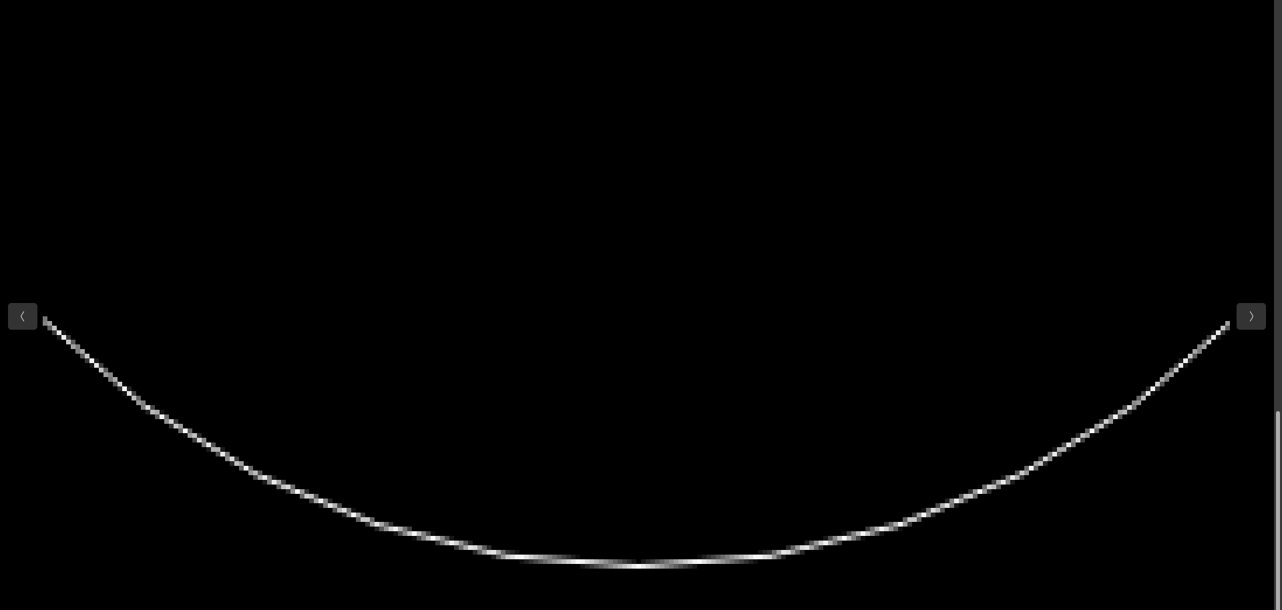
BMP image produced by AntilaiasedLines_x.cpp Now the line has no jaggies, but it has bright and dark sections.

Slide 46
BMP image produced by Line_x.cpp The line has bright and dark sections, even though the sum of the colors in each column is the same. This is because most monitors and projectors compute the output brightness b as a function of the input digital value v as b = v^{γ} where γ is close to 2. This is to make the changes in perceived brightness more similar, rather than have large perceived steps between the darker colors. If γ = 2, we can compensate for this by taking the square root of v.

Slide 47
#define width 400
#define height 400
#define image_size 3*width*height
unsigned char image[image_size];
int gamma_correction = 1;
void set_pixel(int x, int y, double r, double g, double b) {
int index;
if (x >= 0 && x < width && y >= 0 && y < height) {
index = 3*(x + width*y);
if (gamma_correction) {
image[index ] = (unsigned char) 255*sqrt(r);
image[index+1] = (unsigned char) 255*sqrt(g);
image[index+2] = (unsigned char) 255*sqrt(b);
}
else {
image[index ] = (unsigned char) 255*r;
image[index+1] = (unsigned char) 255*g;
image[index+2] = (unsigned char) 255*b;
}
}
}

Slide 48
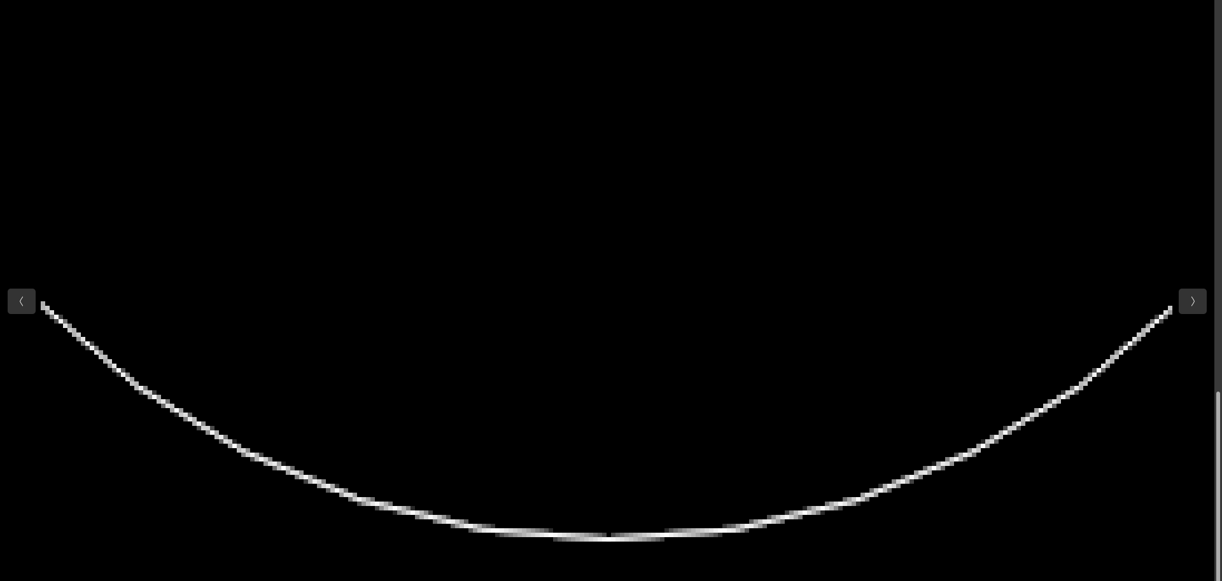
BMP image produced by AntialiasedLines_x.cpp Now the dark sections are gone.

Slide 49
BMP image produced by AntialiasedLines_x.cpp Now the line has no jaggies, but it has bright and dark sections.

Slide 50
Code in AntialiasedLines_x.cpp
xstart = floor(x1);
xstop = floor(x2);
m = (y2 – y1)/(x2 – x1); // slope
y = y1 + (xstart + .5 - x1) * m;
for (x = xstart; x < xstop; ++x) { // this works only when x2 > x1
iy = floor(y);
if(y > iy + .5) { // iy +5 is yc, the y for the center of pixel (x, iy)
ofac = y - (iy + .5);
ffac = 1. - ofac;
set_pixel(x, iy, ffac, ffac, ffac); // for a white line on black
set_pixel(x, iy+1, ofac, ofac, ofac);
}
else {
ofac = iy + .5 - y;
ffac = 1. - ofac;
set_pixel(x, iy-1, ofac, ofac, ofac);
set_pixel(x, iy, ffac, ffac, ffac);
}
y += increment;
}

Slide 51
Code revision in Orange_on_black_antialiased_line_x.cpp
float line_color[3] = {1., .5, 0.}; // orange
for (x = xstart; x < xstop; ++x) { // this works only when x2 > x1
iy = floor(y);
if (y > iy + .5) {
ofac = y - (iy + .5);
ffac = 1. - ofac;
r = ffac*line_color[0];
g = ffac*line_color[1];
b = ffac*line_color[2];
set_pixel(x, iy, r, g, b);
r = ofac*line_color[0];
g = ofac*line_color[1];
b = ofac*line_color[2];
set_pixel(x, iy+1, r, g, b);
}
else { // continue with y <= iy + .5 case
ofac = iy + .5 - y; ...

Slide 52
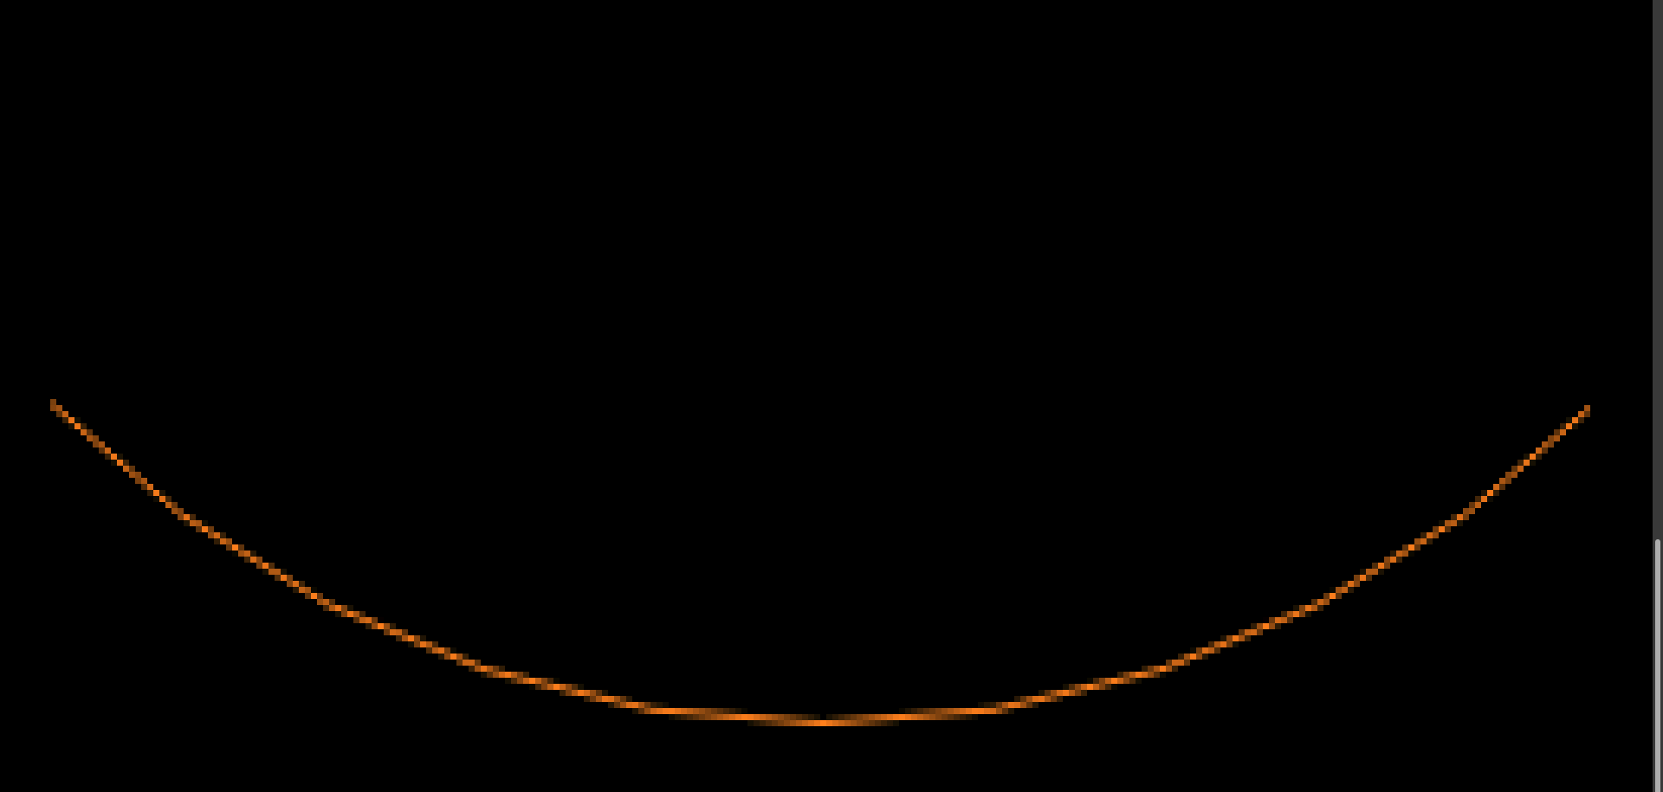
BMP image from Orange_on_black_antialiased_line_x.cpp Now the line has no jaggies, but it has bright and dark sections.

Slide 53
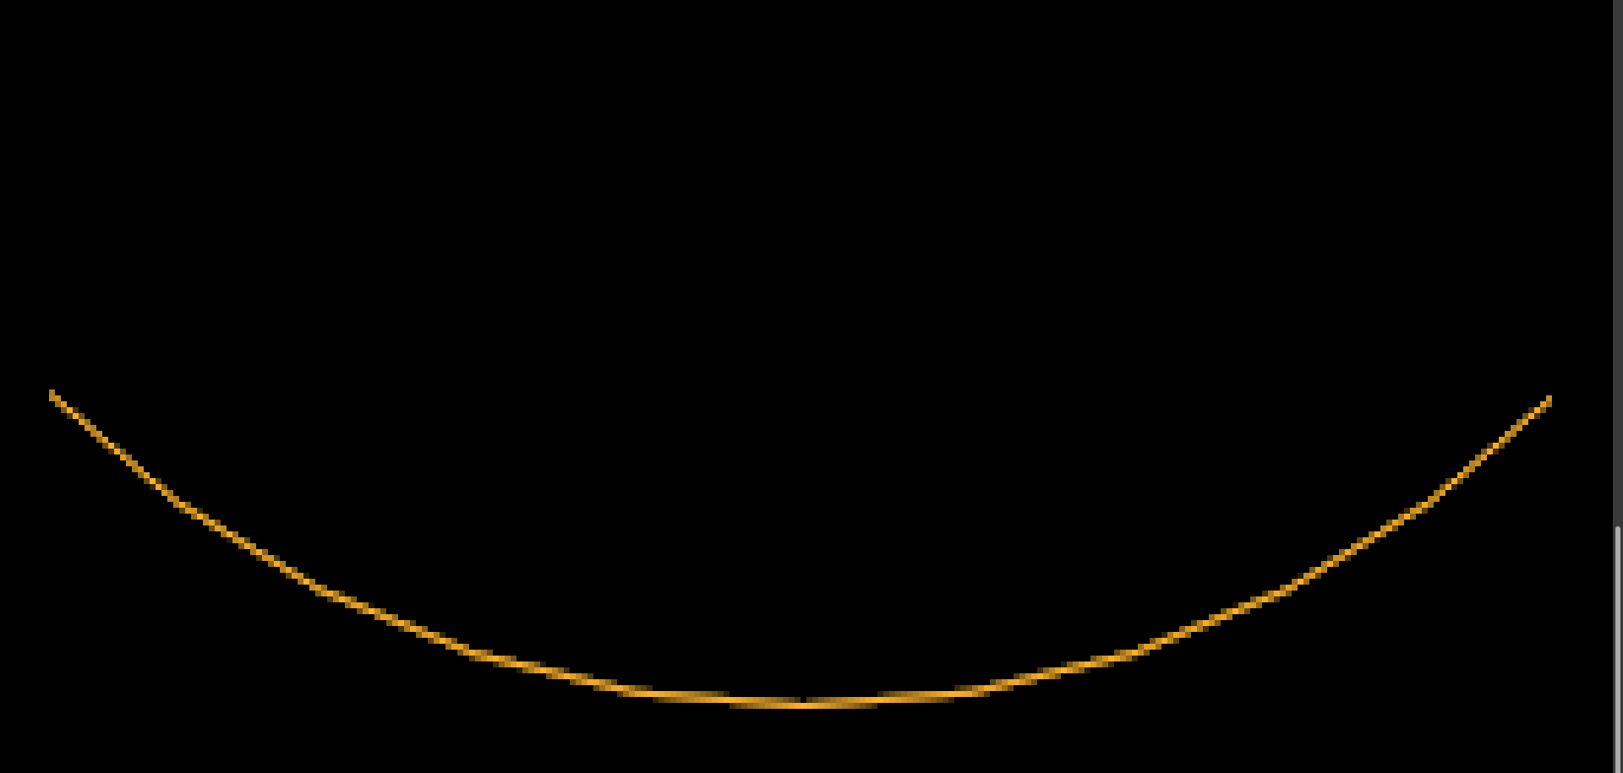
Gamma corrected from Orange_on_black_antialiased_line_x.cpp. Now the dark sections are gone, but the orange line turned yellow. Why?

Slide 54
Now the dark sections are gone, but the orange line turned yellow. Why?
Taking the square root turned (r, g, b) color (1., .5, 0.) to (1., .707, 0).
This has a higher ratio of green to red, so the line looks more yellow.

Slide 55
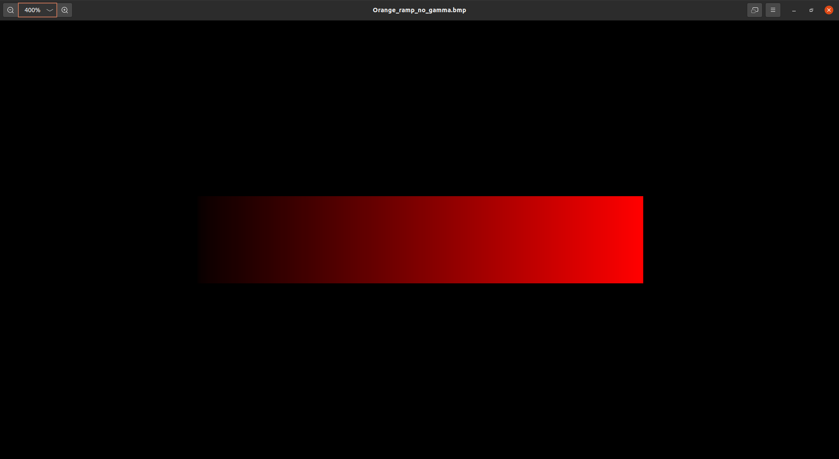
Orange ramp, without gamma correction

Slide 56
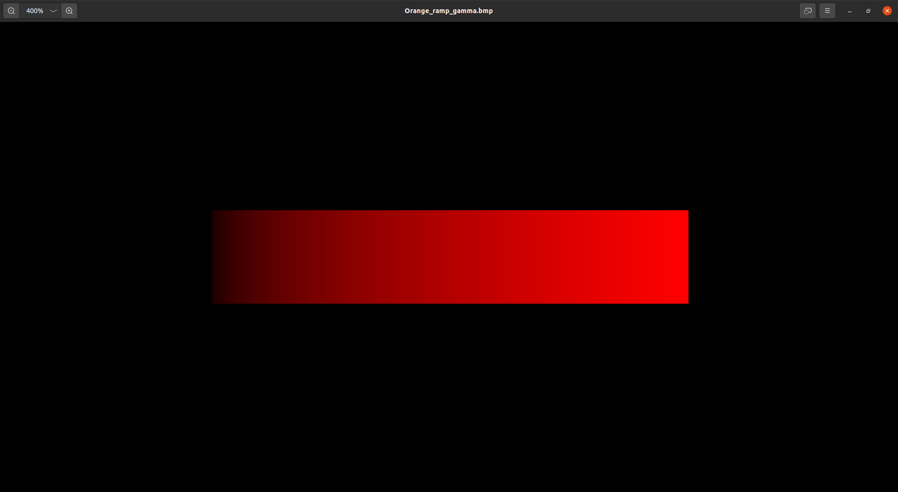
Orange ramp, with gamma correction

